Slide 1
Decision Analysis: Clinical Examples
Paul Gerardo yeh, MD, DrPH
3915 Course
November 7, 2023

Slide 2
Readings
Drummond et. al.., 2015, Chap. 9 “Econ Eval. Using Decision Analytic Modeling
Portnoy et al. Impact and cost-effectiveness of strategies to accelerate cervical cancer elimination: A model-based analysis.
Further Reading:
Briggs et al. (2015) Chap. 3 Further developments in decision analytic models for economic evaluation. In Decision Modeling for Health Economic Evaluation. Oxford, pp. 45-76.
Cantor, Scott B. (1995). Decision Analysis: Theory and Application to Medicine Primary Care (Review for Nov. 3, no presentation)
Rafia, Rachid, Brennan, Alan et al. Modeling the Cost-Effectiveness of Alternative Upper Age Limits for Breast Cancer Screening in England and Wales (Review for Nov. 3, no presentation)
Deshmukh et al. Cost-effectiveness Analysis Comparing Conventional, Hypofractionated, and Intraoperative Radiotherapy for Early-Stage Breast Cancer.

Slide 3
Objectives of Economic Evaluation using Decision Analytic Modeling (Review)
Evaluation
Provides a means of translating the relevant evidence into estimates of the costs and effects of the alternative options being compared.
Uncertainty & Variability
Facilitate an assessment of the various types of uncertainty relating to the evaluation.
Future Research
Through assessment of uncertainty, identify likely priorities for future research.
Decision Science Overview
Example I: Breast Cancer Rads Surgery
Example II: HPV Vaccination
Example III: Breast Cancer Screening
CEA, Decision Science Review
3

Slide 4
Example I
Systematic Approach to Decision-Making Under Uncertainty Applied to Mammography Screening in Older Women
Decision Science Overview
Example I: Breast Cancer Rads Surgery
Example II: HPV Vaccination
Example III: Breast Cancer Screening
CEA, Decision Science Review
4

Slide 5
Example I: Optimal Radiation Therapy for early-stage (I/II) breast cancer
Breast cancer account for highest number of incident cases of cancer in the U.S.
Economic burden is over $158 billion as of 2020
Almost 60% of 250,000 incident cases of breast cancer is early stage (stage I/II) disease
Source: Deshmukh et al., 2017
Decision Science Overview
Example I: Breast Cancer Rads Surgery
Example II: HPV Vaccination
Example III: Breast Cancer Screening
CEA, Decision Science Review

Slide 6
Treatment choices after lumpectomy
Conventional fractionated whole breast irradiation (CF-WBI)
Main adjuvant radiation modality
Externally delivered whole breast radiation treatment (50 Gy in 25 fractions)
Daily treatment for 5-7 weeks
Associated with side-effects, hardships for certain patients (e.g. rural)
Hypofrationated whole breast irradiation (HF-WBI)
Larger dose over shorter time (42.5Gy in 16 fractions)
Equally efficacious with less toxic side-effects vs. CF-WBI
Needs 15-20 sessions of daily treatment
Decision Science Overview
Example I: Breast Cancer Rads Surgery
Example II: HPV Vaccination
Example III: Breast Cancer Screening
CEA, Decision Science Review

Slide 7
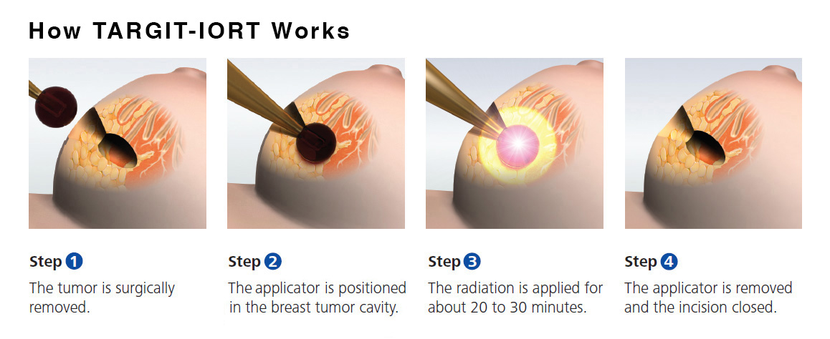
Treatment choices after lumpectomy continued
Intraoperative radiotherapy (IORT)
Single-dose radiation given during breast cancer surgery
More convenient
Cost-saving?
Decision Science Overview
Example I: Breast Cancer Rads Surgery
Example II: HPV Vaccination
Example III: Breast Cancer Screening
CEA, Decision Science Review

Slide 8
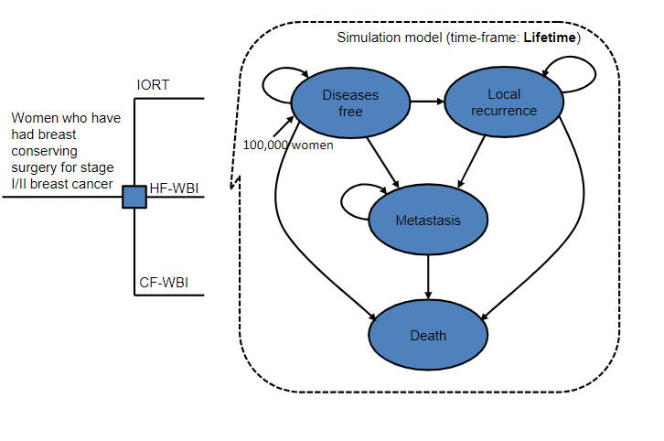
Optimal radiation therapy cost-effectiveness simulation model
Decision Science Overview
Example I: Breast Cancer Rads Surgery
Example II: HPV Vaccination
Example III: Breast Cancer Screening
CEA, Decision Science Review

Slide 9
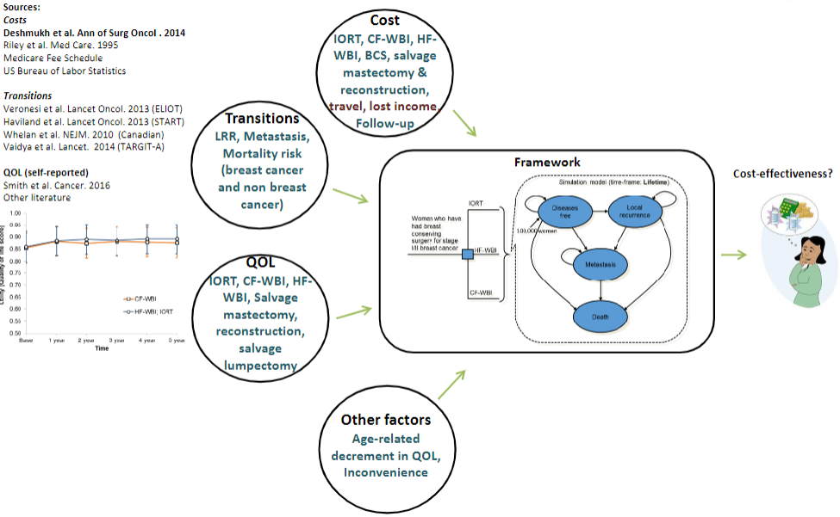
Decision Science Overview
Example I: Breast Cancer Rads Surgery
Example II: HPV Vaccination
Example III: Breast Cancer Screening
CEA, Decision Science Review

Slide 10
Cost-effectiveness results
Strategy | Cost | QALYs | ICER ($/QALY) | Probability of cost-effectiveness at $50,000/QALY | Probability of cost-effectiveness at $100,000/QALY
Societal perspective
IORT | 42,410 | 12.176 | --- | 25% | 20%
CF-WBI | 50,981 | 12.293 | Dominated | 0% | 0%
HF-WBI | 47,486 | 12.4745 | 17,024 | 75% | 80%
Decision Science Overview
Example I: Breast Cancer Rads Surgery
Example II: HPV Vaccination
Example III: Breast Cancer Screening
CEA, Decision Science Review

Slide 11
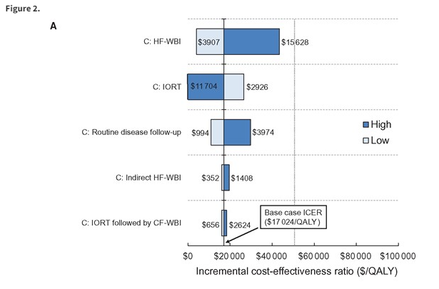
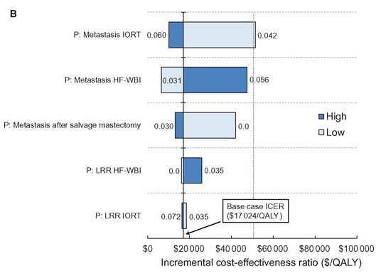
Sensitivity Analyses: Tornado diagrams
Decision Science Overview
Example I: Breast Cancer Rads Surgery
Example II: HPV Vaccination
Example III: Breast Cancer Screening
CEA, Decision Science Review

Slide 12
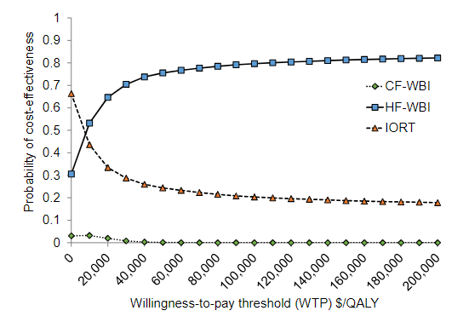
Sensitivity Analyses: Probabilistic sensitivity analysis
Decision Science Overview
Example I: Breast Cancer Rads Surgery
Example II: HPV Vaccination
Example III: Breast Cancer Screening
CEA, Decision Science Review

Slide 13
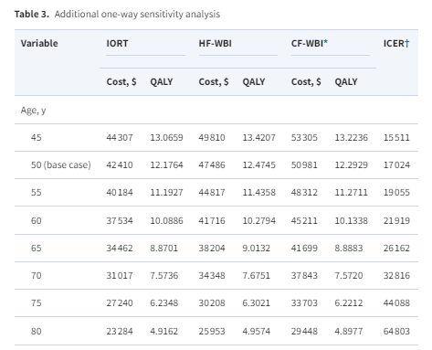
Conclusions of Breast Cancer Radiation Study
Hypofrationated whole breast irradiation (HF-WBI) is the most optimal cost-effective strategy for early stage breast cancer
But what if the cost of IORT decreases? If HF-WBI cost increases?
Older women and women in rural areas with difficulty traveling long distances daily for treatment may benefit from IORT

Slide 14
Example II
Long-term impact of HPV vaccination on oral HPV infection and oropharyngeal cancer
Decision Science Overview
Example I: Breast Cancer Rads Surgery
Example II: HPV Vaccination
Example III: Breast Cancer Screening
CEA, Decision Science Review

Slide 15
Long-term impact of HPV vaccination on oral HPV infection and oropharyngeal cancer
Every year, 33,000 are diagnosed with HPV-related cancer
Oropharyngeal cancer has recently surpassed cervical caner as most common cancer by HPV infection (>13,000 incident cases)
Includes cancer of tonsil, base of tongue, pharyngeal wall, uvala, soft palate
Incidence in men> women
Squamous cell carcinoma is 95% of all oropharyngeal cancers
One of fasting growing causes of cancer death among men
Entirely preventable with HPV vaccination
Decision Science Overview
Example I: Breast Cancer Rads Surgery
Example II: HPV Vaccination
Example III: Breast Cancer Screening
CEA, Decision Science Review

Slide 16
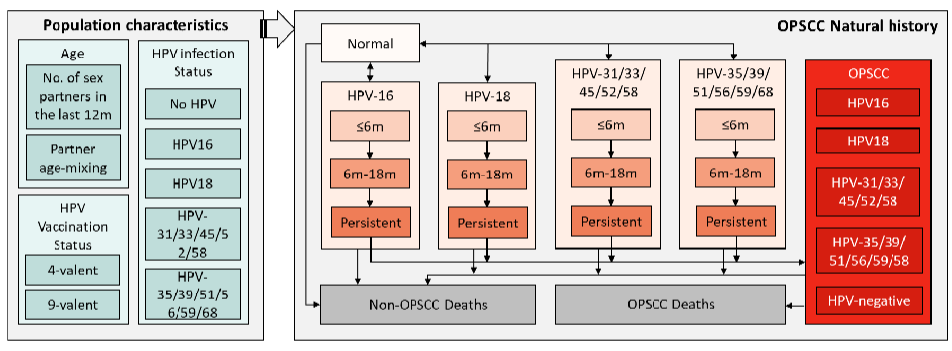
Oropharyngeal cancer simulation model: framework
Decision Science Overview
Example I: Breast Cancer Rads Surgery
Example II: HPV Vaccination
Example III: Breast Cancer Screening
CEA, Decision Science Review

Slide 17
Oropharyngeal cancer simulation model: parameters
Parameters for microsimulation model can be estimated through biological, clinical, or epidemiological studies
Survival time following cancer diagnosis can be derived from CDC SEER data
Other-cause mortality probabilities can be based on Census Bureau Life Tables for each age group
NHANES for epidemiological population-level data
Other sources: HIM Study
Decision Science Overview
Example I: Breast Cancer Rads Surgery
Example II: HPV Vaccination
Example III: Breast Cancer Screening
CEA, Decision Science Review

Slide 18
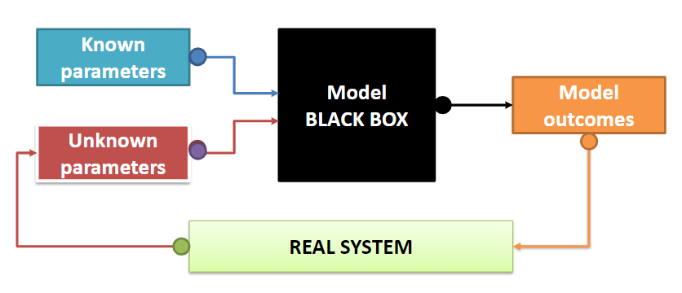
Oropharyngeal cancer simulation model: parameters
Calibration to estimate model parameters to ensure that model reproduces observed results (transition from oral HPV to oropharyngeal squamous cell carcinoma)
Calibration is iterative process of comparing model results to real observed data and making adjustments to model to ensure that results parallel reality

Slide 19
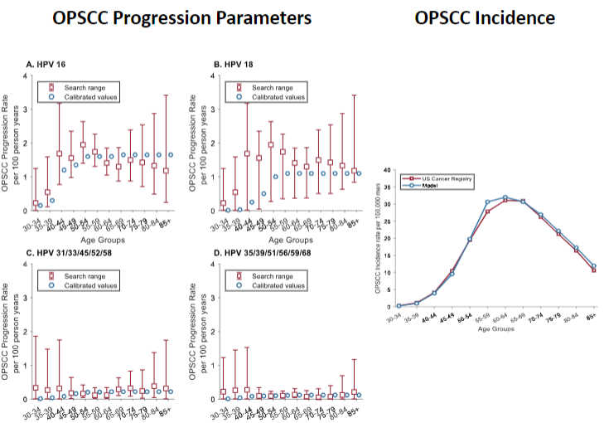

Slide 20
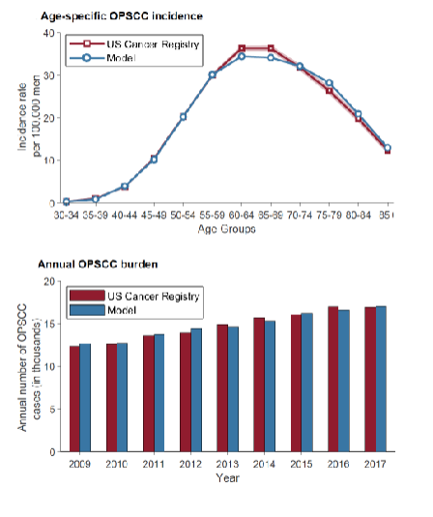
Validating the model
Decision Science Overview
Example I: Breast Cancer Rads Surgery
Example II: HPV Vaccination
Example III: Breast Cancer Screening
CEA, Decision Science Review

Slide 21
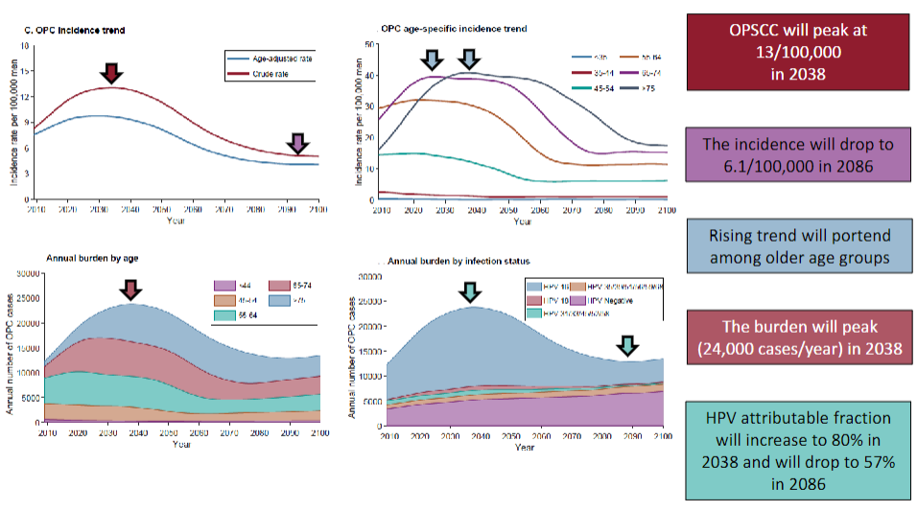
Decision Science Overview
Example I: Breast Cancer Rads Surgery
Example II: HPV Vaccination
Example III: Breast Cancer Screening
CEA, Decision Science Review

Slide 22
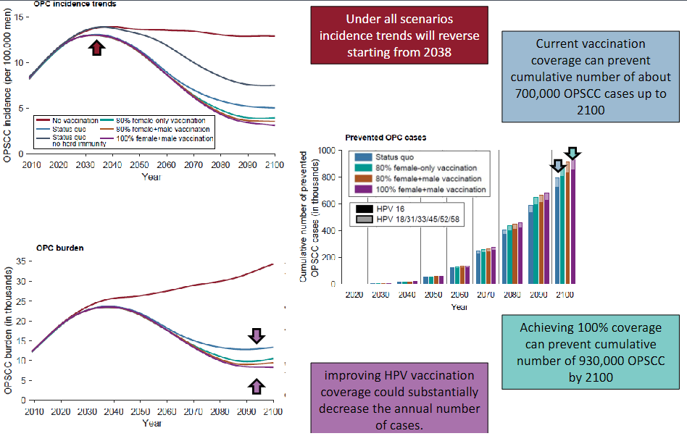
Decision Science Overview
Example I: Breast Cancer Rads Surgery
Example II: HPV Vaccination
Example III: Breast Cancer Screening
CEA, Decision Science Review

Slide 23
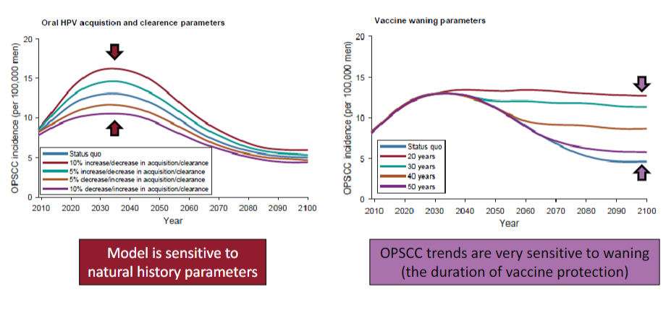
Decision Science Overview
Example I: Breast Cancer Rads Surgery
Example II: HPV Vaccination
Example III: Breast Cancer Screening
CEA, Decision Science Review

Slide 24
Conclusion of Study Example II
Microsimulation is powerful took for modeling prevention and intervention policies in public health
Requires long time and programming skills
Living model that can be updated with updated data or elaborated with new functionalities (e.g., investigating new intervention or population)
More dynamic microsimulations exist (transmission-based microsimulations of infection/cancer)
Decision Science Overview
Example I: Breast Cancer Rads Surgery
Example II: HPV Vaccination
Example III: Breast Cancer Screening
CEA, Decision Science Review

Slide 25
Example III
A Simplified Didactic Example of Cost-Effectiveness Analysis of Mammography Screening
Utilizing a Decision Tree Model
Based on: JS Mandelblatt, ME Wheat, M Monane, R Moshief, JP Hollenberg, J Tang. Breast cancer screening for elderly women with and without comorbid conditions: a decision analysis model. Annals of Internal Medicine. 1992;116:722-730.
Decision Science Overview
Example I: Breast Cancer Rads Surgery
Example II: HPV Vaccination
Example III: Breast Cancer Screening
CEA, Decision Science Review

Slide 26
Breast Cancer Scrn. Background
Breast cancer most common type of cancer among women and second leading cause of death
2022: 287,850 new cases and 43,250 deaths*
Incidence and death rates highest in older women**
Of all incident BC cases (2010-14) about 20% occurred in women ≥ 75 yrs.
In (2010-14, among all BC related mortality 36.8% of women were ≥ 75 yrs.
Decision Science Overview
Example I: Breast Cancer Rads Surgery
Example II: HPV Vaccination
Example III: Breast Cancer Screening
CEA, Decision Science Review
Notes:
* SEER.cancer.gov. Mack, D. and Lapane, K. Screening Mammography Among Older Women:
**A Review of United States Guidelines and Potential Harms. Journal of Women’s Health, Vol. 28, No. 6, 2019.

Slide 27
Background (cont.)
Guidelines for older women are inconsistent
CDC (2020)
Age 40-49, individual choice.
Age 50-74 average risk; once every two years.
Age ≥ 75 years insufficient evidence to judge balance of risks and benefits.
ACS (2021)
Age 45 to 54 annual,
Age 55 & older can switch to a mammogram every other year, or they can choose to continue yearly mammograms. Screening should continue as long as a woman is in good health and is expected to live ≥ 10 years
Decision Science Overview
Example I: Breast Cancer Rads Surgery
Example II: HPV Vaccination
Example III: Breast Cancer Screening
CEA, Decision Science Review

Slide 28
Background (cont.)
Clinical trials evidence: Screening reduces mortality 15-30% after 4 years for women 40-69 years.
Screening rate is lower in older women
60-70% age 50-69
50-60% age 70 and older
Mack, D. and Lapane, K. Screening Mammography Among Older Women: A Review of United States Guidelines and Potential Harms. Journal of Women’s Health, Vol. 28, No. 6, 2019.
Decision Science Overview
Example I: Breast Cancer Rads Surgery
Example II: HPV Vaccination
Example III: Breast Cancer Screening
CEA, Decision Science Review

Slide 29
Policy Issue
Medicare Part B covers annual screens and waves the co-pay
Should the government be doing more?
Yes:
If mammography screening is cost-effective in older women
If there are cost-effective interventions to increase screening
Decision Science Overview
Example I: Breast Cancer Rads Surgery
Example II: HPV Vaccination
Example III: Breast Cancer Screening
CEA, Decision Science Review

Slide 30
Mandelblatt et al. Study Objectives
Determine the incremental cost-effectiveness of mammography screening compared to no screening to prevent late stage breast cancer.
Study Population
Women in five different age groups, three health groups (average health, HTN, CHF), and average-health African American women.
Research Design
Decision tree model using probabilities and expected survival from related literature to predict outcomes of the average person who chooses to screen or not.

Slide 31
Basic Decision Tree Model
Alternative Actions: Expected value of screening vs. no screening
Uncertainties: Cancer, no cancer, Screen results, follow-up results, stage at diagnosis, survival
Outcomes: Expected life years and cost
Decision Science Overview
Example I: Breast Cancer Rads Surgery
Example II: HPV Vaccination
Example III: Breast Cancer Screening
CEA, Decision Science Review

Slide 32
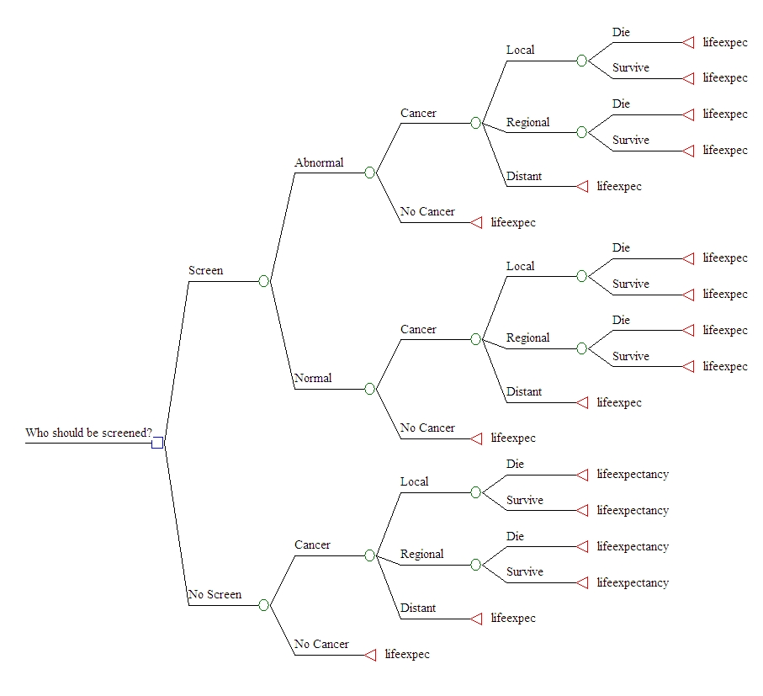
Structure of Mandelblatt’s decision tree model of one- time breast cancer screening

Slide 33
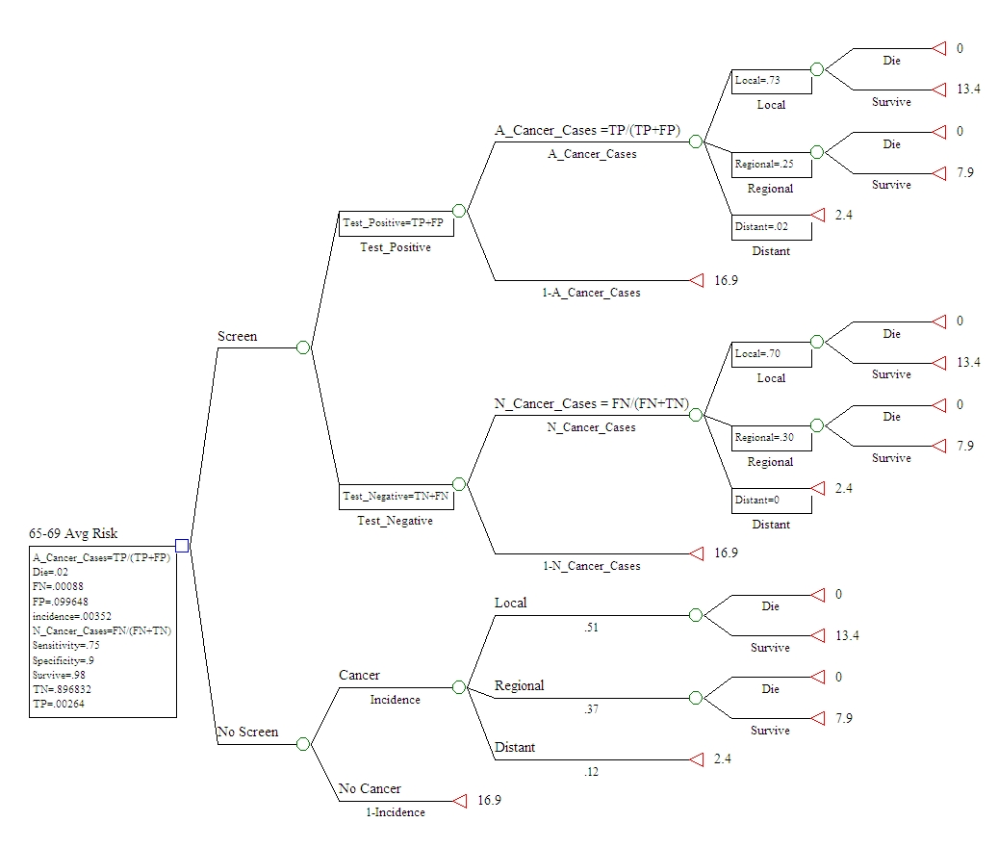
Model structure with probabilities
and life expectancies

Slide 34
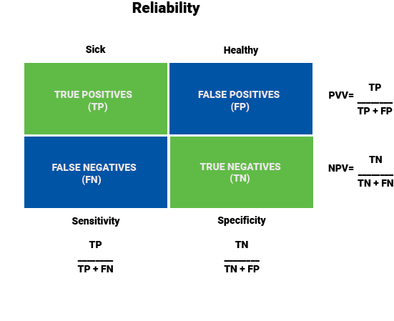
Screening Test Parameters
Have Disease Not Have Disease
Positive Test
Negative Test

Slide 35
Probabilities for Decision Tree
Prob. Test Positive = True Positive + False Positive
TP=(incidence*sensitivity) FP=((non-disease in pop*(1-specificity))
Prob. Test Negative = True Negative + False Negative
TN=(non-disease in pop*specificity) FN= ((incidence*(1-sensitivity))
Prob. Cancer If Test Positive: TP/(TP+FP)
Prob. No Cancer if Test Positive: FP/(TP+FP)
Estimates from screening test studies and incidence of the disease in the target population.
Prob Local if Cancer: .73 for TP, .70 for FN, .51 for Nonscreeners
Prob Regional if Cancer: .25 for TP, .30 for FN, .37 for Nonscreeners
Prob Distant if Cancer: .02 for TP, .00 for FN, .12 for Nonscreeners
Prob Operative Death: .02 (Estimates based on cancer Epi. Studies)
Notes:
Sensitivity= out of all those who do have cancer, how many would test positive?
Specificity= out of those who do not have cancer, how many would test negative?
TP = true positive test
FP = false positive test
TN = true negative test
FN = false negative test

Slide 36
Screening Test Probabilities
 | Disease Present | Disease Absent | Total
Test + | .00264 TP | .099648 FP | .102288 TP+FP
Test - | .00088 FN | .896832 TN | .897712 TN+FN
Total | .00352 | .99648 | 1.00
Source: Mandelblatte et al. 1992

Slide 37
Decision Science Overview
Example I: Breast Cancer Rads Surgery
Example II: HPV Vaccination
Example III: Breast Cancer Screening
CEA, Decision Science Review

Slide 38
Decision Science Overview
Example I: Breast Cancer Rads Surgery
Example II: HPV Vaccination
Example III: Breast Cancer Screening
CEA, Decision Science Review

Slide 39
Decision Science Overview
Example I: Breast Cancer Rads Surgery
Example II: HPV Vaccination
Example III: Breast Cancer Screening
CEA, Decision Science Review

Slide 41
Outcomes
Survival
Age 65 to 69 years, average health
Local BC 13.4
Regional BC 7.9
Distant BC 2.4
No Cancer 16.9
Do the numbers make sense (face validity)?
Decision Science Overview
Example I: Breast Cancer Rads Surgery
Example II: HPV Vaccination
Example III: Breast Cancer Screening
CEA, Decision Science Review
Source: Mandelblatte et al. 1992

Slide 42
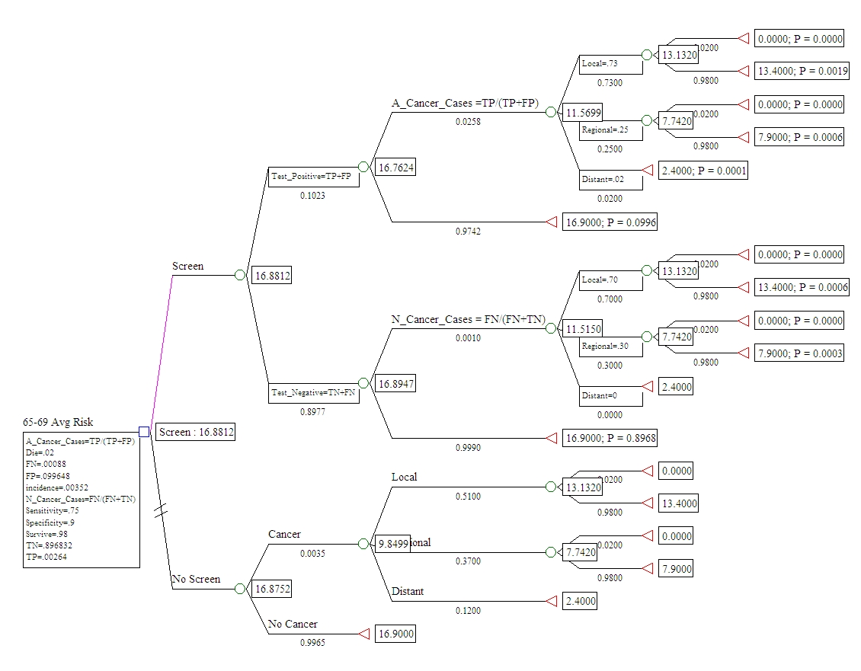

Expected Life Years if Screened with Local Cancer = (.02*0)+(.98*13.4) = 13.132
Expected Life Years if Screened with Any Type of Cancer = (.73*13.132)+(.25*7.742)+(.02*2.4) = 11.5699
Expected Life Years if Screened with Abnormal (Positive) Result = (.0258*11.5699)+(.9742*16.9) = 16.7624
Expected Life Years if Screened = (.1023*16.7624)+(.8977*16.8947) = 16.8812

Slide 43
Calculation of Expected Survival for Screening
Work decision tree backward from right to left:
Value of a terminal node is its expected payoff
Expected Life Years if Screened with Local Cancer = (.02*0)+(.98*13.4) = 13.132
Expected Life Years if Screened with Any Type of Cancer = (.73*13.132)+(.25*7.742)+(.02*2.4) = 11.5699
Expected Life Years if Screened with Abnormal (Positive) Result = (.0258*11.5699)+(.9742*16.9) = 16.7624
Expected Life Years if Screened = (.1023*16.7624)+(.8977*16.8947) = 16.8812
Decision Science Overview
Example I: Breast Cancer Rads Surgery
Example II: HPV Vaccination
Example III: Breast Cancer Screening
CEA, Decision Science Review

Slide 44
Value of Screening: Practical
Expected Life Years Gain of Screening vs. Non-Screening
= 16.8812-16.8752
= .006 years
= .006*365 = 2.19 days
Decision Science Overview
Example I: Breast Cancer Rads Surgery
Example II: HPV Vaccination
Example III: Breast Cancer Screening
CEA, Decision Science Review

Slide 45
Costs of Screening, 1992 USD
Category Cost $
Marginal cost of clinical breast exam during
routine visit for other conditions 8
Screening mammography (two-view) 65
Total outpatient costs of diagnostic work-up for
abnormal screening Mammogram 657
Incisional biopsy 170
Localization 46
Pathology reading 30
Two physician visits 62
Facility costs 275
Mammogram for diagnosis 74

Slide 46
Expected Incremental Cost of Screening per Individual
Cost of mammography $73.58
Expected cost of biopsy for true- and false- positives of screening .1023*$657= $67.20
Total Cost of Screening $73.58 + $67.20 = $140.78
Diagnostic Cost of Non-Screen 0.00352 * $657 = 2.30
Incremental Cost of Screening $140.78 – $2.30 = $138.48
Decision Science Overview
Example I: Breast Cancer Rads Surgery
Example II: HPV Vaccination
Example III: Breast Cancer Screening
CEA, Decision Science Review
Notes:
Diagnostic cost for those not screened = .00352 x $657
= $2.30

Slide 47
Cost-Effectiveness Analysis Average Risk Women 65-69 yrs.
 | Strategy | Cost $ | Incr. Cost $ | Avg. Eff yrs. of life | Incr. Eff yrs. of life | ICER $
 | No Screen* | 2.30 | 0 | 16.8752 | 0 | 0
 | Screen | 140.78 | 138.48 | 16.8812 | 0.006 | 23,080
*Non-screeners experience diagnostic cost when identified by symptoms.
Decision Science Overview
Example I: Breast Cancer Rads Surgery
Example II: HPV Vaccination
Example III: Breast Cancer Screening
CEA, Decision Science Review

Slide 48
Results
Compared with no screening, the incremental cost-effectiveness of screening a 65-69 year old asymptomatic woman with average health
Incremental C/E ratio = $ 138/.006
~ $ 23,000
Decision Science Overview
Example I: Breast Cancer Rads Surgery
Example II: HPV Vaccination
Example III: Breast Cancer Screening
CEA, Decision Science Review

Slide 49
Sensitivity Analysis: Changing the Incidence Rate of BC
VARIABLE
VARIABLE
S
STRATEGY
COST
EFF
CE
INCRCOST
INCREFF
INCRCE
0.00176
incidence
No Screen
1.15
16.88
0.068
0
0
0
Base Case Incidence= 0.00352
0.00176
incidence
Screen
139.74
16.89
8.273
138.58
0.00298
46,559
Base Case ICER= $23,080
0.00308
incidence
No Screen
2.02
16.87
0.119
0
0
0
0.00308
incidence
Screen
140.52
16.88
8.322
138.49
0.00521
26,588
0.0044
incidence
No Screen
2.89
16.86
0.171
0
0
0
0.00
44
incidence
Screen
141.30
16.87
8.372
138.41
0.00744
18,600
0.00572
incidence
No Screen
3.75
16.85977
0.222
0
0
0
0.00572
incidence
Screen
142.08
16.86945
8.422
138.32
0.00967
14,299,
0.00704
incidence
No Screen
4.62
16.85049
0.274
0
0
0
0.00704
incidence
Screen
142.86
16.8624
8.472
138.23
0.01191
11,610

Slide 50
Replicate for 85+ Age Group with Major Comorbidity
Calculate Probabilities
Roll Back to Estimate Expected Life Years of Screeners and Nonscreeners
Assume Incremental Cost of Screening = $140
Calculate C/E ratio
Decision Science Overview
Example I: Breast Cancer Rads Surgery
Example II: HPV Vaccination
Example III: Breast Cancer Screening
CEA, Decision Science Review

Slide 51
Value of Screening 85+
Increase in Expected Life Years=
4.9958 - 4.9944 =
.0014 years =
.0014*365 = .51 days
Decision Science Overview
Example I: Breast Cancer Rads Surgery
Example II: HPV Vaccination
Example III: Breast Cancer Screening
CEA, Decision Science Review

Slide 52
Results 85+
Compared with no screening, the incremental cost-effectiveness of screening a 85+ year old woman with major co-morbidity
Incremental C/E ratio =
$140/.0014 = $100,000
Decision Science Overview
Example I: Breast Cancer Rads Surgery
Example II: HPV Vaccination
Example III: Breast Cancer Screening
CEA, Decision Science Review

Slide 53
Sensitivity Analysis
Results were most sensitive to:
The incidence of cancer
Quality of life adjustments.
Results were less sensitive to:
Perioperative mortality
Test characteristics (e.g., PPV, NPV, Specificity, Sensitivity)
Stage distribution with false negative screening results.
Decision Science Overview
Example I: Breast Cancer Rads Surgery
Example II: HPV Vaccination
Example III: Breast Cancer Screening
CEA, Decision Science Review

Slide 54
Sensitivity Analysis (quality of life)
Impact of Long-Term Quality of Life Adjustments (Mandelblatt et al. Table 4)
Savings gained from screening persisted for all age, race, and health groups.
Impact of Short- and Long-Term Quality of Life Adjustments (Mandelblatt et al. Table 5)
All QALYS were about .5 days lower than in unadjusted model. This resulted in a net loss in QALYS due to screening for women ≥ 85 years old.
Decision Science Overview
Example I: Breast Cancer Rads Surgery
Example II: HPV Vaccination
Example III: Breast Cancer Screening
CEA, Decision Science Review

Slide 55
Study Limitations
Assumed 100% adherence to screening.
Quality of life assumed, not measured.
Screen test estimates from studies of younger women.
Cost of cancer treatment not included.
One time screening. Dynamic model required to model repeat screening over time.
Current models based on Markov process or micro simulation.
Decision Science Overview
Example I: Breast Cancer Rads Surgery
Example II: HPV Vaccination
Example III: Breast Cancer Screening
CEA, Decision Science Review

Slide 56
Summary
Screening is effective for older women with and without comorbidity.
Screening is more cost-effective in Black women and less cost-effective in oldest women and women with comorbidity.
The cost-effectiveness of screening ranges from $23,000 for a 65-69 year old with average health to $100,000 for a 85+ year old woman with major co-morbidity.
Decision Science Overview
Example I: Breast Cancer Rads Surgery
Example II: HPV Vaccination
Example III: Breast Cancer Screening
CEA, Decision Science Review

Slide 57
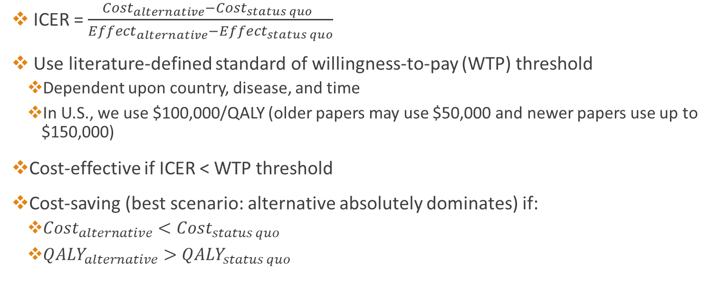
CEA Review (Again)
ICER = $\frac{{Cost}_{alternative}−{Cost}_{status quo} }{{Effect}_{alternative}−{Effect}_{status quo}}$
Use literature-defined standard of willingness-to-pay (WTP) threshold
Dependent upon country, disease, and time
In U.S., we use $100,000/QALY (older papers may use $50,000 and newer papers use up to $150,000)
Cost-effective if ICER < WTP threshold
Cost-saving (best scenario: alternative absolutely dominates) if:
${Cost}_{alternative}<{Cost}_{status quo}$
${QALY}_{alternative}>{QALY}_{status quo}$
Decision Science Overview
Example I: Breast Cancer Rads Surgery
Example II: HPV Vaccination
Example III: Breast Cancer Screening
CEA, Decision Science Review
57

Slide 58
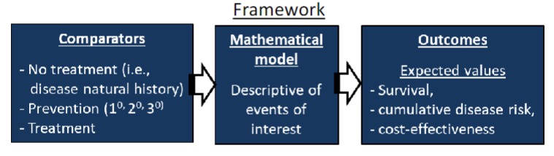
Clinical Decision Science Review Again
A quantitative method for evaluating decisions between multiple alternatives under conditions of uncertainty
Is this like real life?
Why use decision science analytics?
To project the future effects (and costs) of an intervention vs. status-quo
When it is unethical or impractical to run a clinical trial
Decision Science Overview
Example I: Breast Cancer Rads Surgery
Example II: HPV Vaccination
Example III: Breast Cancer Screening
CEA, Decision Science Review
58

Slide 59
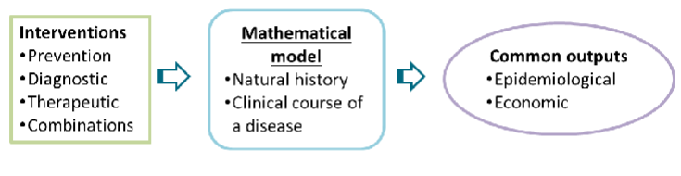
Decision Science Modeling Review Again
Mathematical model framework
Disease natural history: disease progression without intervention
Clinical course of disease: Disease prognosis and treatment outcomes after disease is initially diagnosed
Epidemiological outcomes: Disease prevalence, incidence, burden
Economic outcomes: Resource utilization for disease treatment, lifetime costs of treatment, cost-effectiveness, QALYs gained
Decision Science Overview
Example I: Breast Cancer Rads Surgery
Example II: HPV Vaccination
Example III: Breast Cancer Screening
CEA, Decision Science Review
59

Slide 60
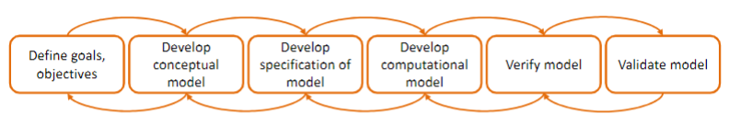
Decision Analytic Modeling Review
Determine what is your ultimate goal for the model?
The model is a PLATFORM for you to achieve your goal
Goals can change with increasing insight
Conceptual model: determine your alternatives, health states, outcomes
Collect data (e.g. literature) from populate model
Develop simulation model using Excel, Treeage, etc.
Ensure that model results make sense. Computation = specification model
Compare results to another model or population data, other models
Decision Science Overview
Example I: Breast Cancer Rads Surgery
Example II: HPV Vaccination
Example III: Breast Cancer Screening
CEA, Decision Science Review
60

